Slide 1

[Samsung PRISM] Monthly Discussion 2
Filter Duplicate Images
Team
College Professors:
Dr. Gayathri M / gayathrm2@srmist.edu.in
Dr. M. Suganiya / suganiym@srmist.edu.in
Students:
Kanupriya Johari / kg3878@srmist.edu.in
Diptayan Jash / dj2037@srmist.edu.in
Tuhina Tripathi / tt4102@srmist.edu.in
Avya Rathod / ad0713@srmist.edu.in
Department: Department of Computing Technologies, SRM Institute of Science and Technology
Date: 27 March 2024

Slide 2
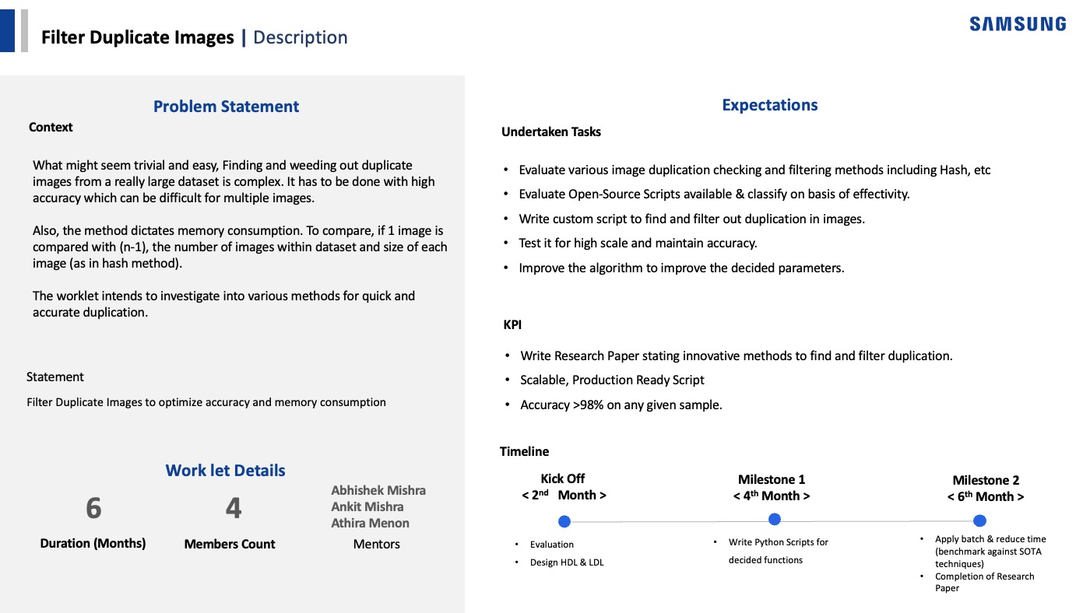

Slide 3
Last month Project Progress (Week 7 - Week 11)
Week | Work Progress | Remarks
Week 7 | Enhanced implementation accuracy Explored additional methods for optimization. | Working on ways to improve time complexity.
Week 8 | Integrated SIFT algorithm into our dataset Optimized feature extraction for other models | Didn’t work well initially, but after a few optimizations, it works but also removes a few non-duplicate images.
Week 9 | Started writing the Research Paper writing. Uploaded SIFT implementation after refining to GitHub. | We decided that we require a larger dataset to more thoroughly test our implementations.
Week 10 | Fine tuned the SIFT implementation. Mailed Universities regarding broader dataset. | Works great on smaller dataset. Working on refining the method.
Week 11 | Finding a larger dataset to test the accuracy of the CLIP. Restructuring the github repo | Finding a larger dataset to test the accuracy of the CLIP model.

Slide 4
Work-let Name: Filter Duplicate Images
Worklet Details
Worklet ID: 23RSG40SRM
College Name: SRM institute of Science and technology
KPIs achieved till now
Explored various hashing techniques, P-hash and D-hash, giving most effective results.
Implementing open-source scripts like OpenAI CLIP and SIFT algorithm for detection of duplicate images
Started working on the research paper.
Procuring a good enough dataset for testing and training models.
Removing the false duplicates and storing only the unique images.
Any Challenges/ Issues faced
Next Steps
Test scalability.
Feedback from the mentors to proceed with a particular method of deduplication.
Achieved filtering of duplicate images without heavy computation. Average time taken was 1 to 2 minute.
Key Achievements/ Outcome till now
Date: 28 Feb, 2024

Slide 5
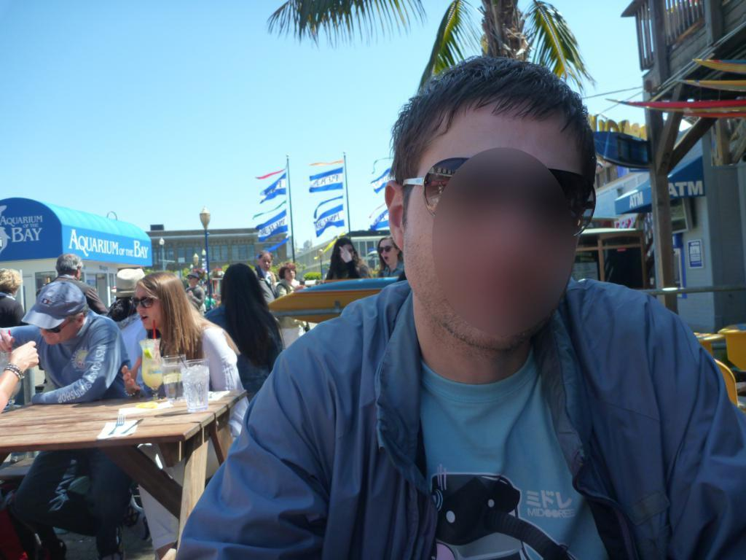
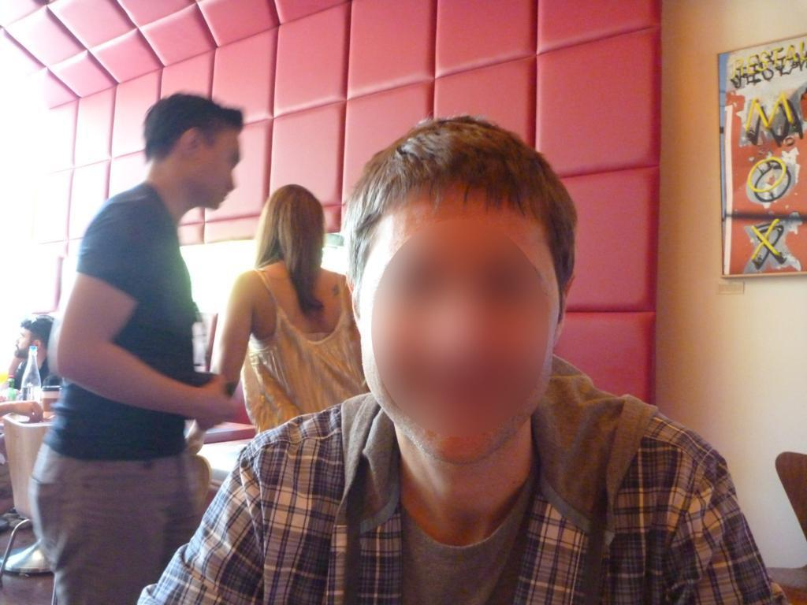
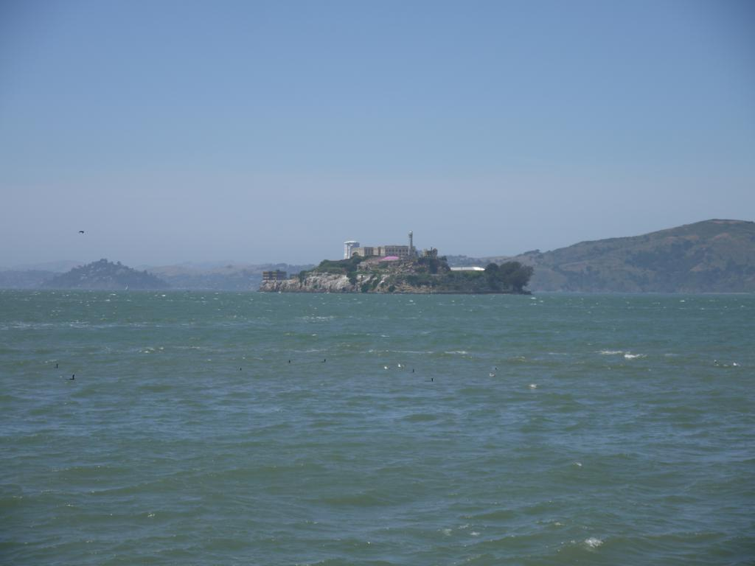
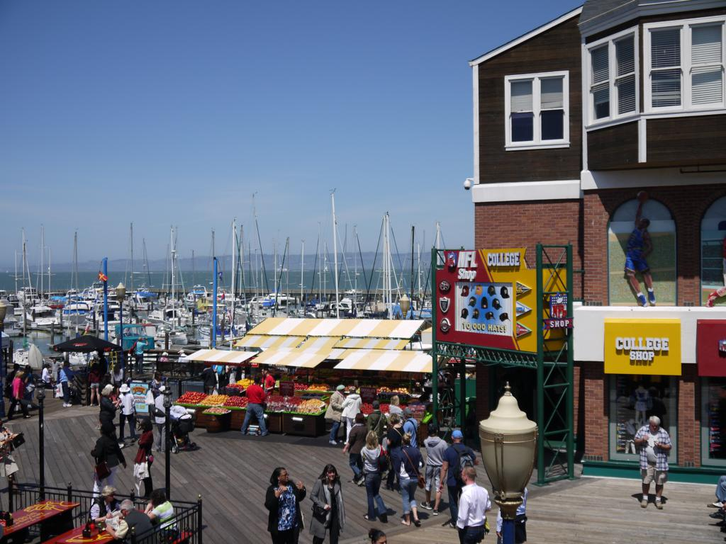
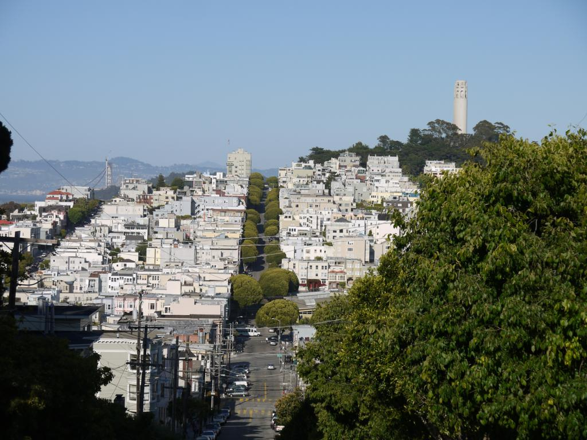
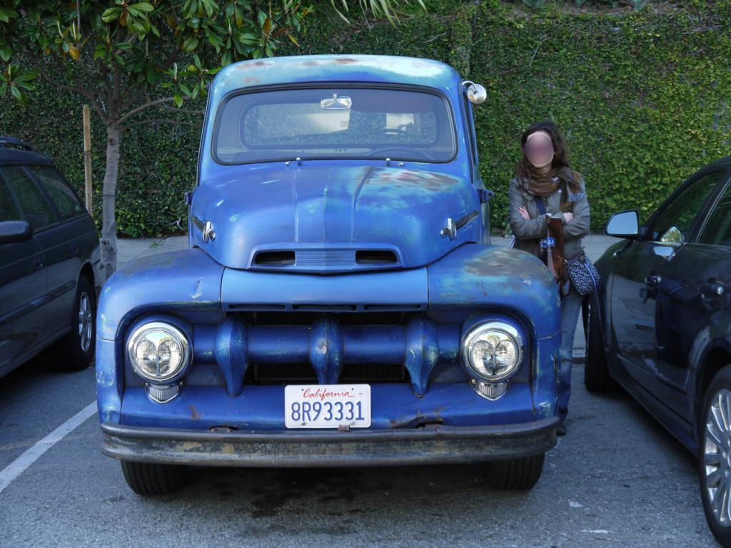
Image samples from the dataset
Dataset: California ND (704 total images)

Slide 6
Results and Observations
Work done | Results | Bottlenecks
Difference hashing (D-hash) Perceptual hashing (P-hash) OpenAI Clip Model Scale-Invariant Feature Transform (SIFT) SURF / ORB | Works only on 1:1 (exact) duplicates. Works on near duplicate images. Takes a bit of time to cache the model. Works perfectly, immune to changes in brightness and contrast. SIFT is open-source but does not work well in this scenario. SURF is not open-source, ORB is an alternative to SURF. | Sometimes the duplicates images are repeated and classified as false duplicates. Clip model takes fairly large amount of time to compute. P-hash and D-hash are affected by the changes in brightness and contrast. SIFT works best in smaller dataset. In bigger dataset, it flags unique images as duplicates. SURF is not working with the current dataset.

Slide 7
Comparisons
D-hash | P-hash | Clip | SIFT
Works only on 1:1 duplicates i.e if the images are exact copy of each other. Very quickly calculates the duplicates. | Works on near duplicates. If the images have same brightness and contrast. It successfully identifies the duplicates Average time: 20s. | Works in all the cases. Average time: 4 min Depends upon the GPU we will be using. | Works best in smaller dataset. Lesser time ~ 10s

Slide 8
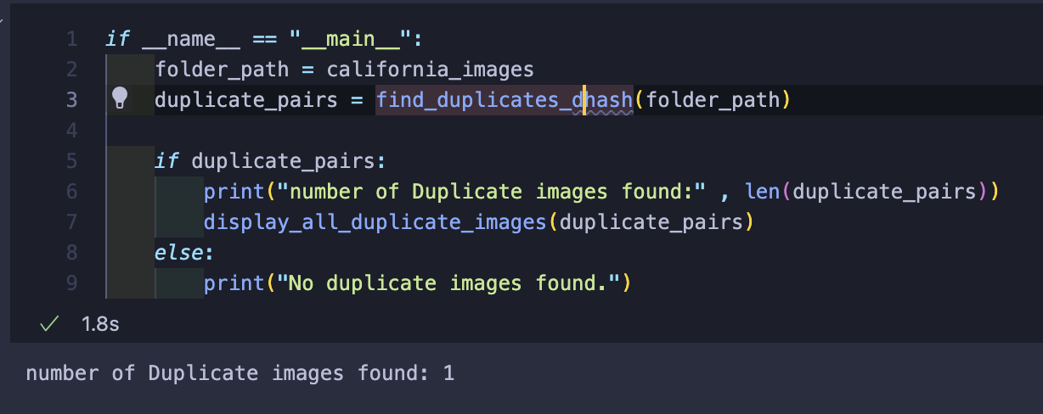
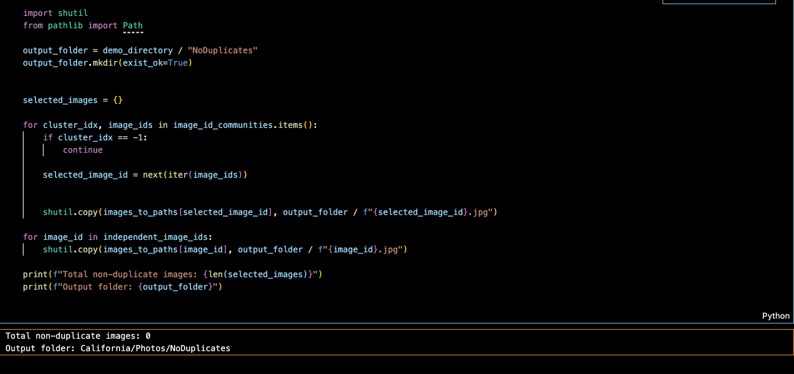
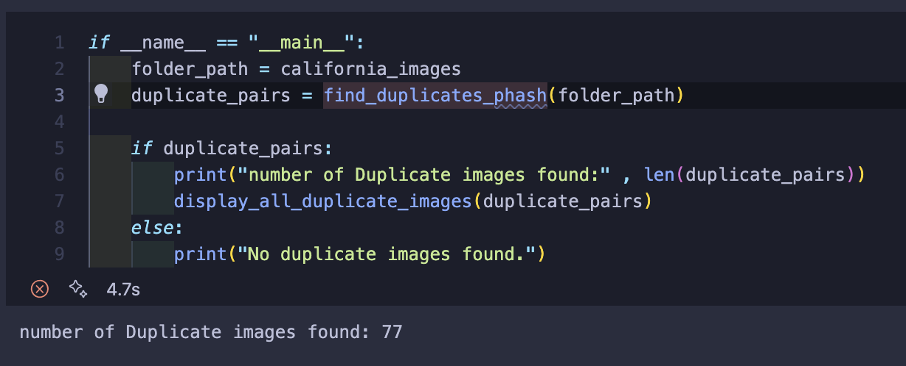
RESULTS
D-hash
Clip - Stores images in the Non - Duplicates folder which now has 0 duplicates
P-hash

